Slide 1
Talking Multiplication Models
This power point presentation is designed to use in multiple ways:
Slide 2 can be used with a computer display or smart board. Each speech bubble is a picture than can be selected and moved to one of the three models.
Slide 3-5 may be printed out to use on a document camera. Place slide 3 on the camera. Cut out the speech balloons so you or your students can place expressions on each of the models as students discuss how to match the models with the expressions.
Alternatively, print and cut out the speech balloons (Slide 4 & 5) and laminate them. Display slide 3 on the board or hand them out to small groups along with the collection of speech balloons. Use tape or magnets to hold the speech bubbles over the appropriate models.
Answers will vary. One possible answer is on slide 6. Allow students to argue and decide which is correct. To learn about task, see my Half-a-Blog on “Multiplication: Lost in Translation”, which discusses that all answers are acceptable. This task is to formatively assess your students understanding of multiplication models, commutativity, and their understanding that 1/3 of 12 is a multiplication statement.

Slide 2
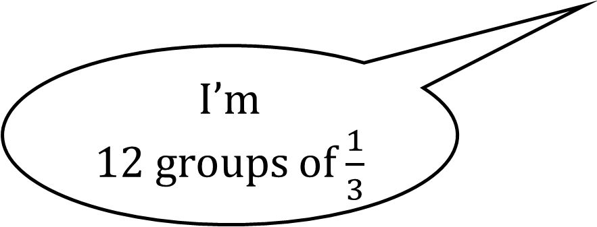
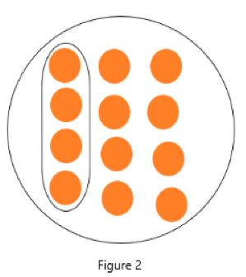
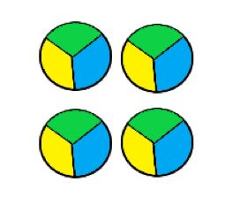
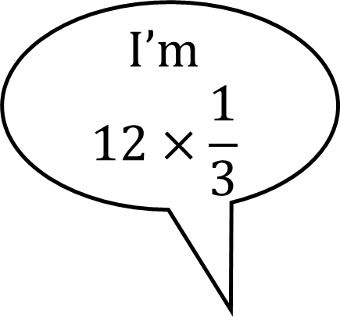
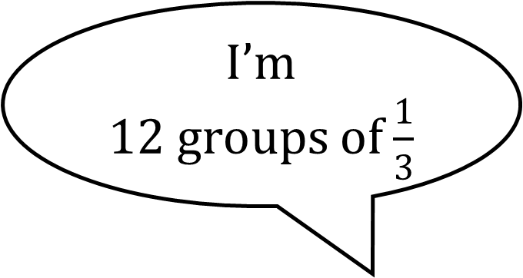
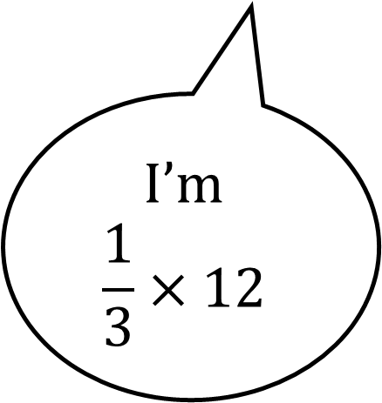
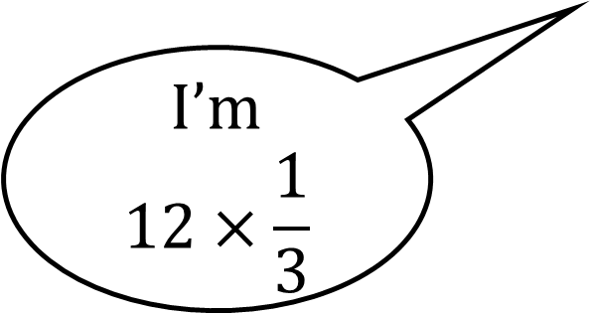
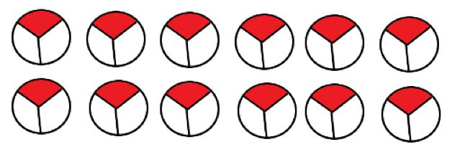
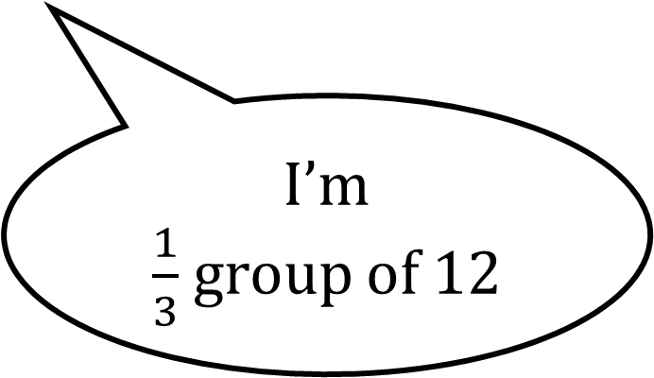
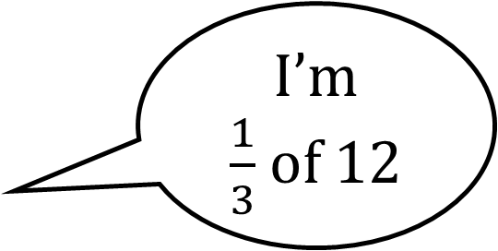
2
1
3

Slide 3
1
2
3

Slide 4
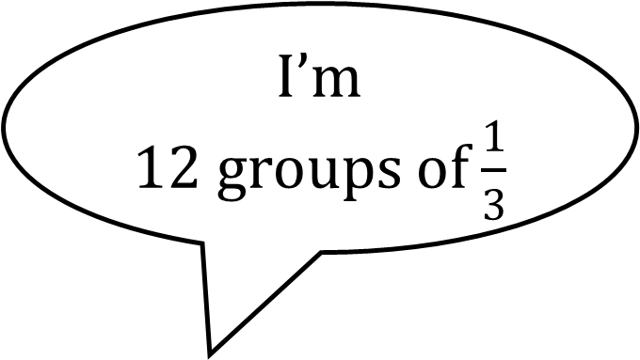
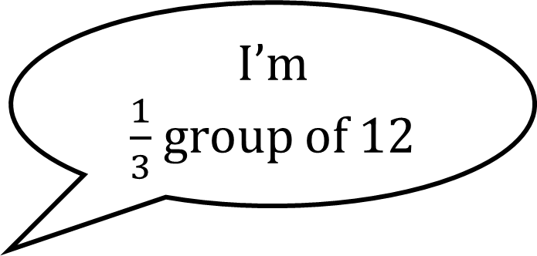
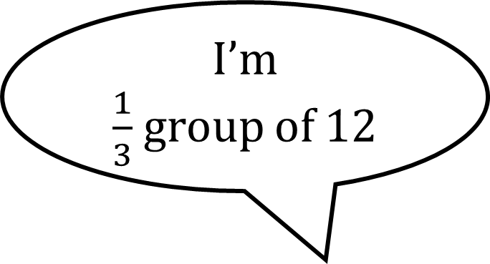

Slide 5
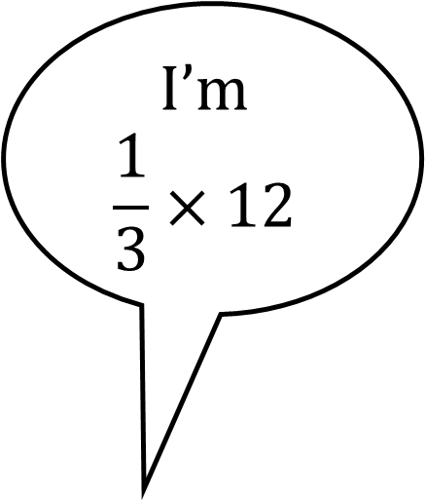
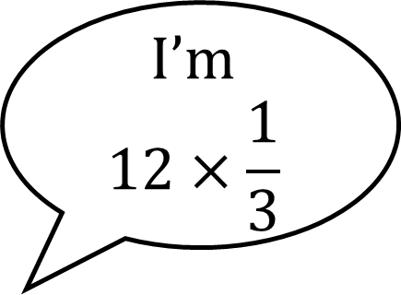
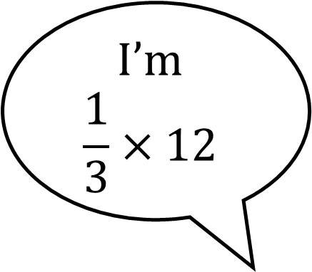
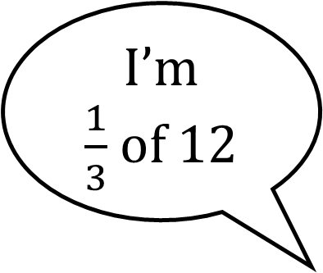
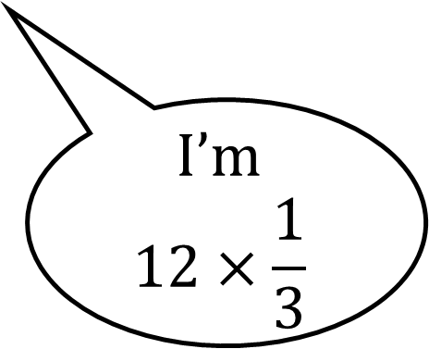
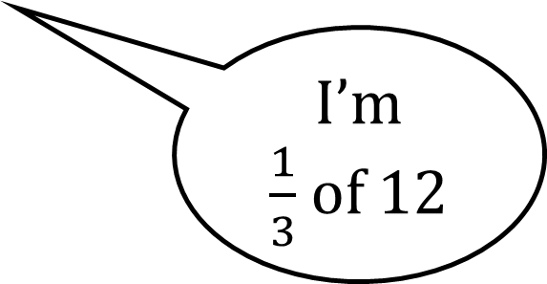

Slide 6
2
1
3

